Slide 1
Computer vision: models, learning and inference
Chapter 15
Models for transformations
Please send errata to s.prince@cs.ucl.ac.uk

Slide 2
Structure
Transformation models
Learning and inference in transformation models
Three problems
Exterior orientation
Calibration
Reconstruction
Properties of the homography
Robust estimation of transformations
Applications
Computer vision: models, learning and inference. ©2011 Simon J.D. Prince
2

Slide 3
Transformation models
Consider viewing a planar scene
There is now a 1 to 1 mapping between points on the plane and points in the image
We will investigate models for this 1 to 1 mapping
Euclidean
Similarity
Affine transform
Homography
Computer vision: models, learning and inference. ©2011 Simon J.D. Prince
3

Slide 4
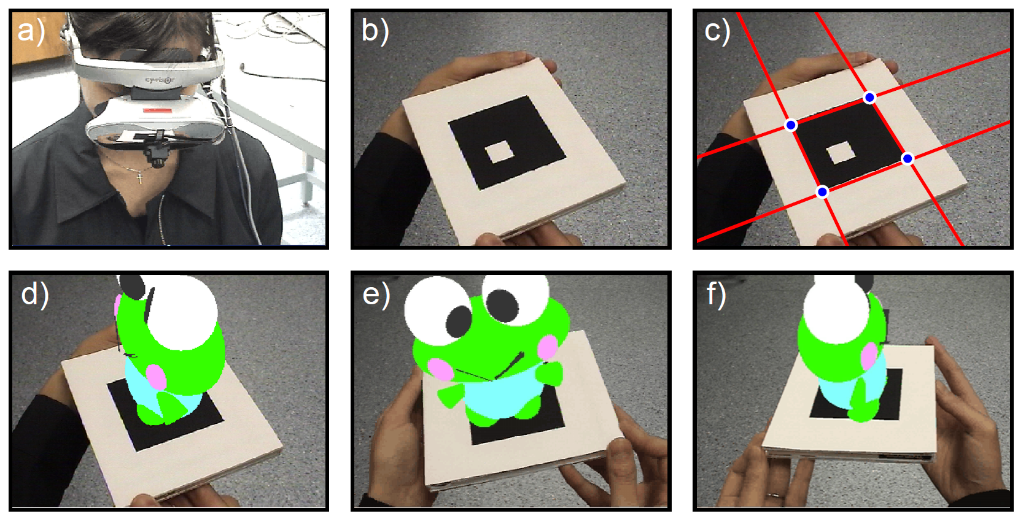
Motivation: augmented reality tracking
Computer vision: models, learning and inference. ©2011 Simon J.D. Prince
4

Slide 5
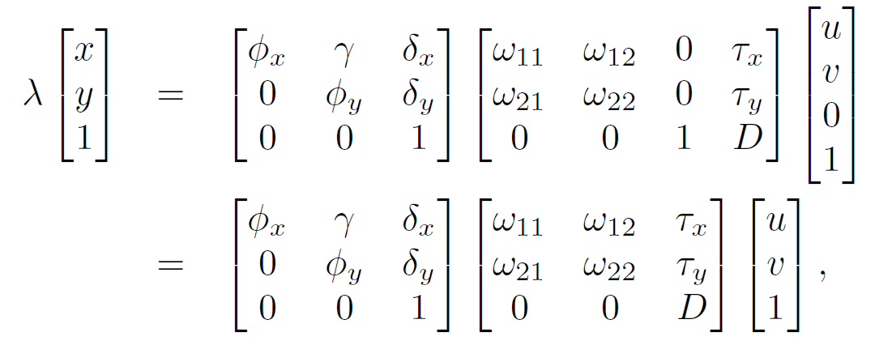






Euclidean Transformation
Consider viewing a fronto-parallel plane at a known distance D.
In homogeneous coordinates the imaging equations are:
3D rotation matrix
becomes 2D (in plane)
Plane at known distance D
Point is on plane (w=0)
Computer vision: models, learning and inference. ©2011 Simon J.D. Prince
5

Slide 6
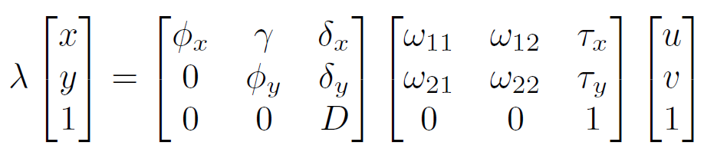
Euclidean Transformation
Simplifying
Rearranging the last equation
Computer vision: models, learning and inference. ©2011 Simon J.D. Prince
6

Slide 7
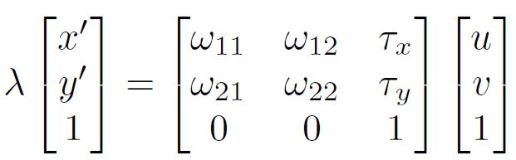
Euclidean Transformation
Pre-multiplying by inverse of (modified) intrinsic matrix
Computer vision: models, learning and inference. ©2011 Simon J.D. Prince
7

Slide 8
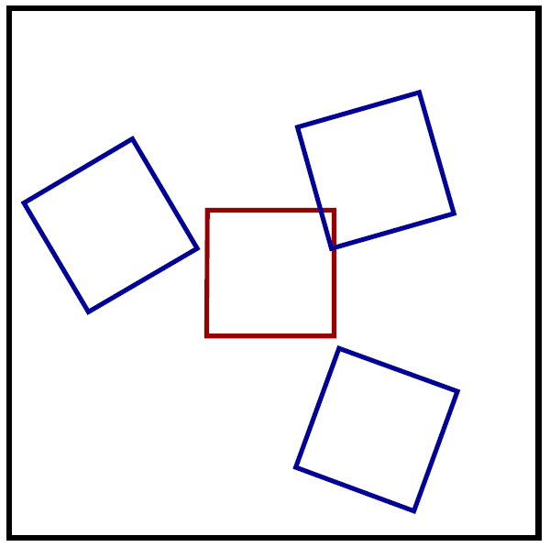
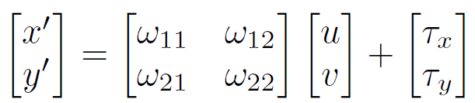
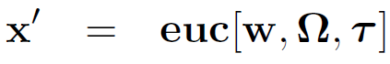
Euclidean Transformation
Homogeneous:
Cartesian:
or for short:
For short:
Computer vision: models, learning and inference. ©2011 Simon J.D. Prince
8

Slide 9
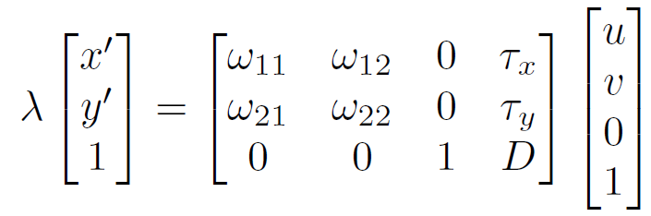
Similarity Transformation
Consider viewing fronto-parallel plane at unknown distance D
By same logic as before we have
Premultiplying by inverse of intrinsic matrix
Computer vision: models, learning and inference. ©2011 Simon J.D. Prince
9

Slide 10
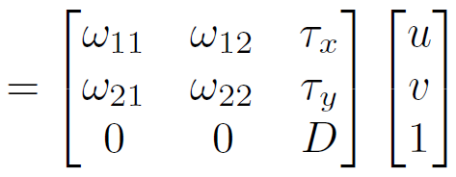
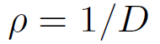
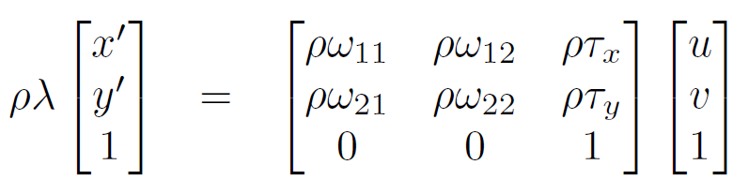
Similarity Transformation
Simplifying:
Multiply each equation by :
Computer vision: models, learning and inference. ©2011 Simon J.D. Prince
10

Slide 11
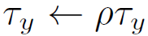
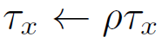
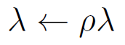
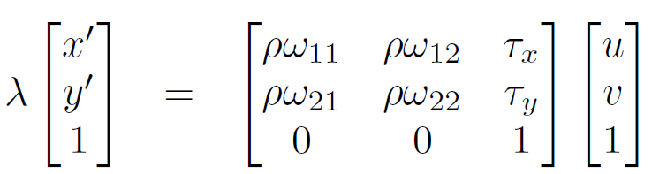
Similarity Transformation
Simplifying:
Incorporate the constants by defining:
Computer vision: models, learning and inference. ©2011 Simon J.D. Prince
11

Slide 12
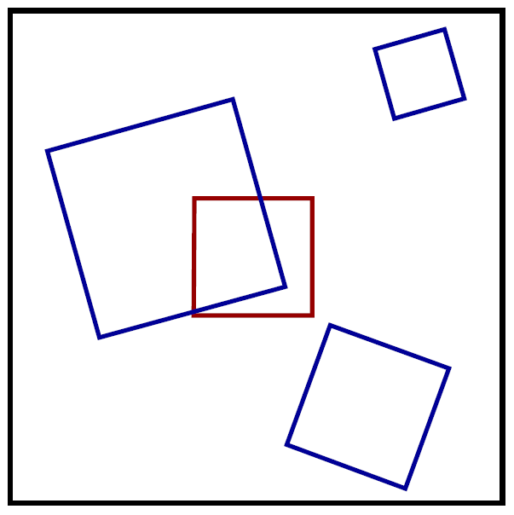
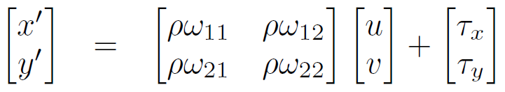
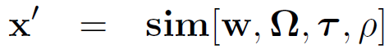
Similarity Transformation
Homogeneous:
Cartesian:
For short:
Computer vision: models, learning and inference. ©2011 Simon J.D. Prince
12

Slide 13
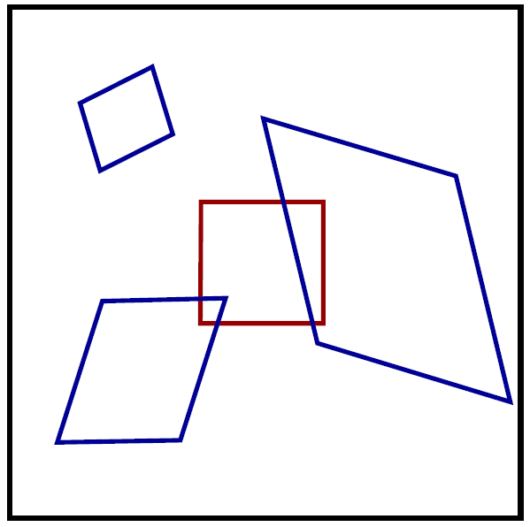
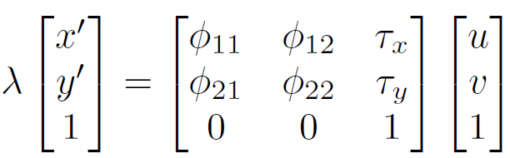
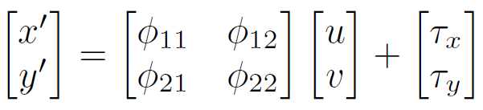
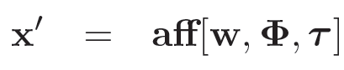
Affine Transformation
Homogeneous:
Cartesian:
For short:
Computer vision: models, learning and inference. ©2011 Simon J.D. Prince
13

Slide 14
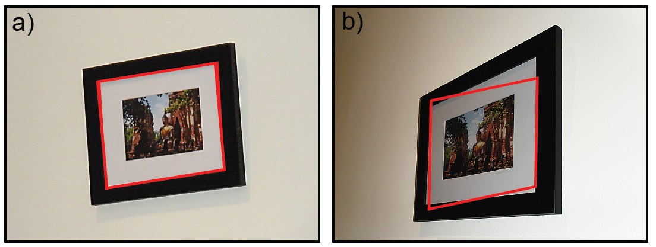



Affine Transform
Affine transform describes mapping well when the depth variation within the planar object is small and the camera is far away
When variation in depth is comparable to distance to object then the affine transformation is not a good model. Here we need the homography
Computer vision: models, learning and inference. ©2011 Simon J.D. Prince
14

Slide 15
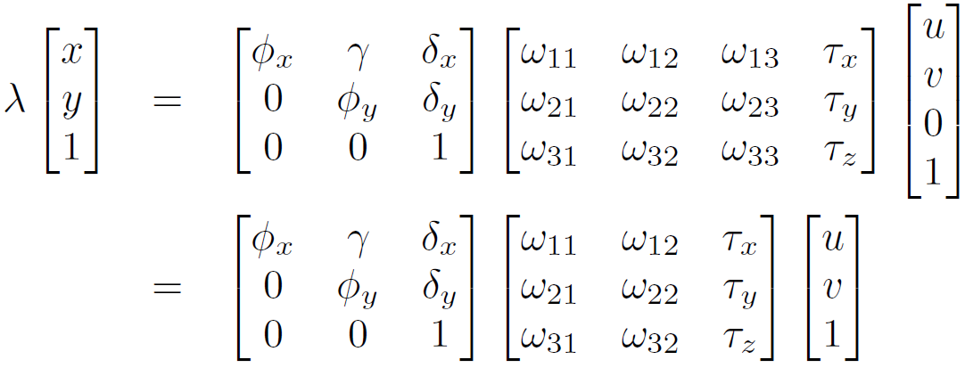
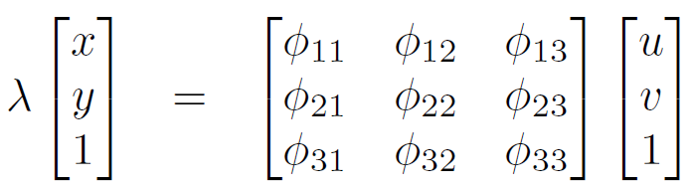
Projective transformation / collinearity / homography
Start with basic projection equation:
Combining these two matrices we get:
Computer vision: models, learning and inference. ©2011 Simon J.D. Prince
15

Slide 16
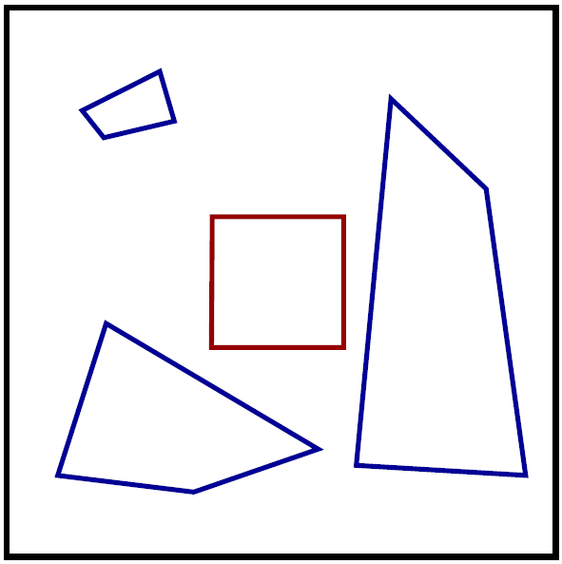
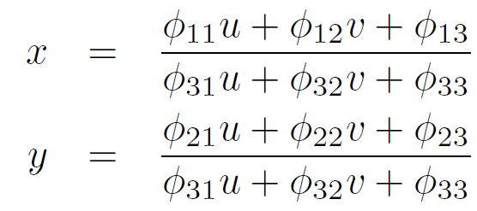
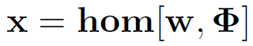
Homography
Homogeneous:
Cartesian:
For short:
Computer vision: models, learning and inference. ©2011 Simon J.D. Prince
16

Slide 17
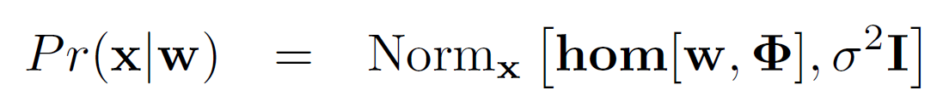
Modeling for noise
In the real world, the measured image positions are uncertain.
We model this with a normal distribution
e.g.
Computer vision: models, learning and inference. ©2011 Simon J.D. Prince
17

Slide 18
Structure
Transformation models
Learning and inference in transformation models
Three problems
Exterior orientation
Calibration
Reconstruction
Properties of the homography
Robust estimation of transformations
Applications
Computer vision: models, learning and inference. ©2011 Simon J.D. Prince
18

Slide 19
Learning and inference problems
Learning – take points on plane and their projections into the image and learn transformation parameters
Inference – take the projection of a point in the image and establish point on plane
Computer vision: models, learning and inference. ©2011 Simon J.D. Prince
19

Slide 20
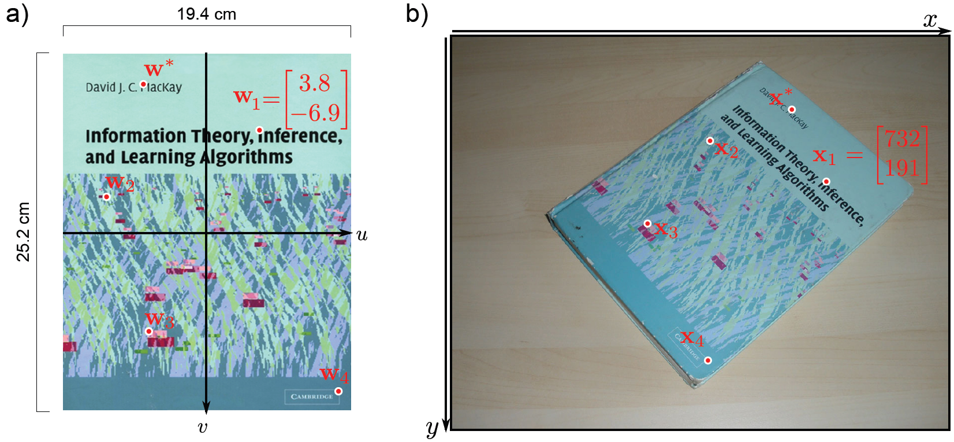
Learning and inference problems
Computer vision: models, learning and inference. ©2011 Simon J.D. Prince
20

Slide 21
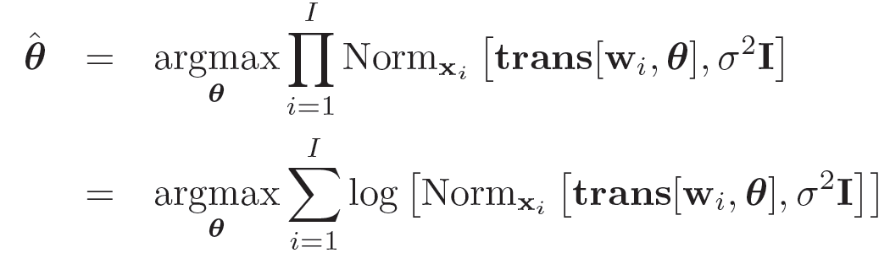
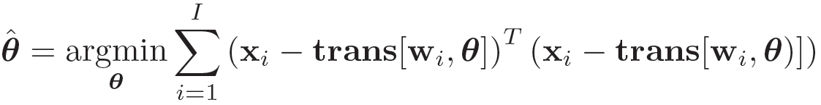
Learning transformation models
Maximum likelihood approach
Becomes a least squares problem
Computer vision: models, learning and inference. ©2011 Simon J.D. Prince
21

Slide 22
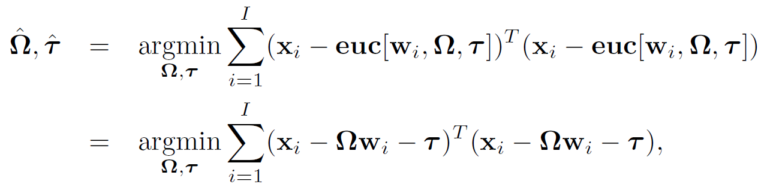
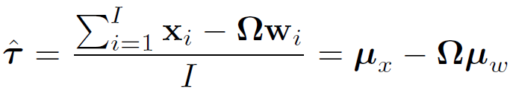
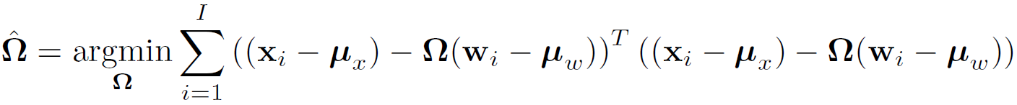
Learning Euclidean parameters
Solve for transformation:
Remaining problem:
Computer vision: models, learning and inference. ©2011 Simon J.D. Prince
22

Slide 23
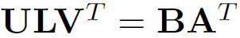
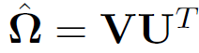


Learning Euclidean parameters
Has the general form:
This is an orthogonal Procrustes problem. To solve:
Compute SVD
And then set
Computer vision: models, learning and inference. ©2011 Simon J.D. Prince
23

Slide 24
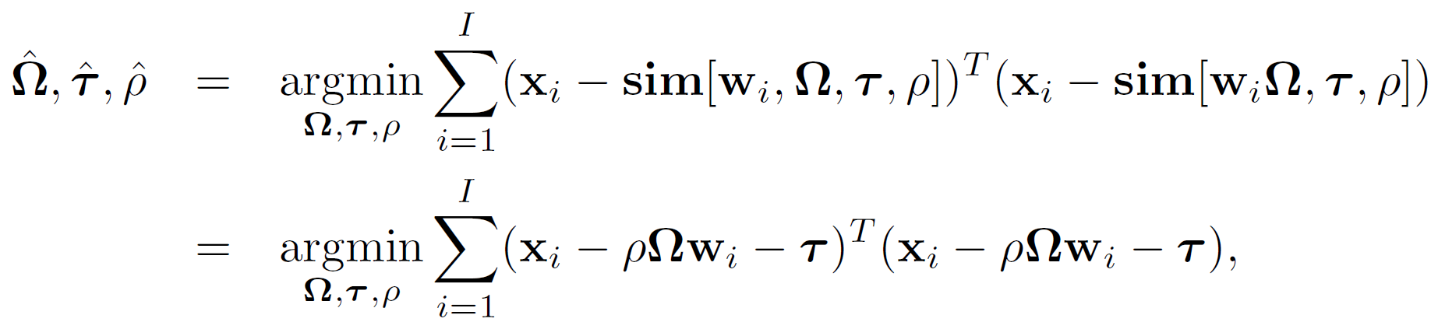
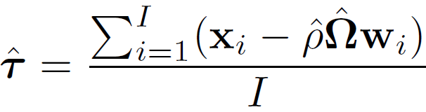
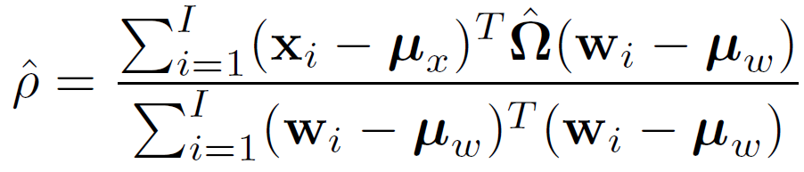
Learning similarity parameters
Solve for rotation matrix as before
Solve for translation and scaling factor
Computer vision: models, learning and inference. ©2011 Simon J.D. Prince
24

Slide 25
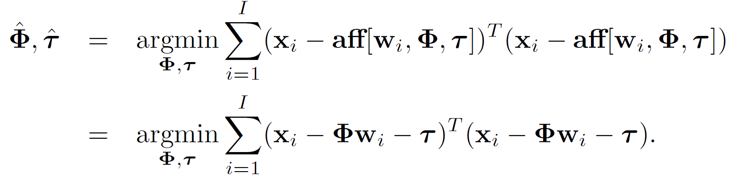
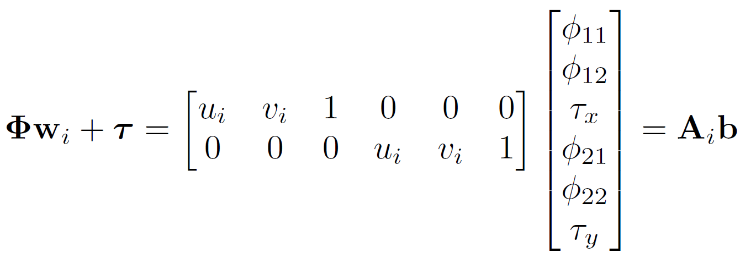
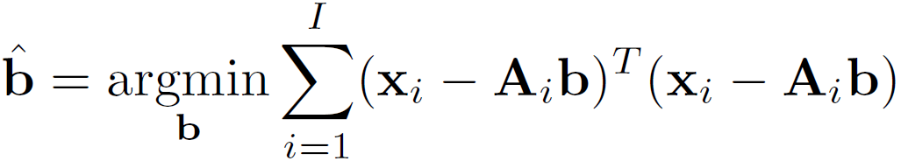
Learning affine parameters
Affine transform is linear
Solve using least-squares solution
Computer vision: models, learning and inference. ©2011 Simon J.D. Prince
25

Slide 26
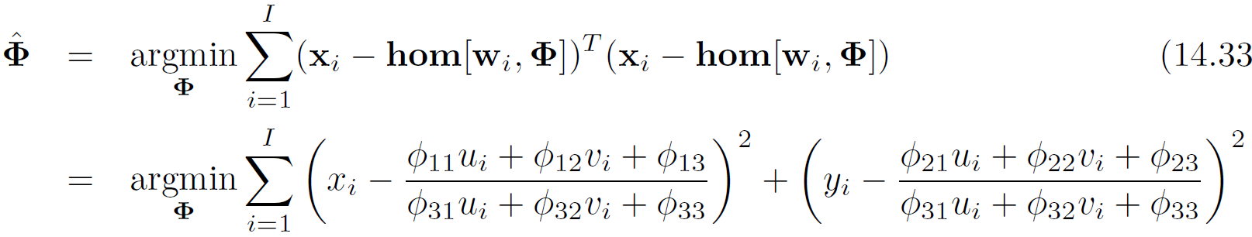
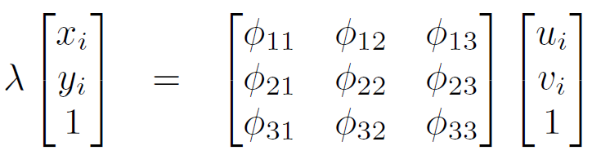
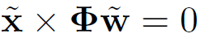

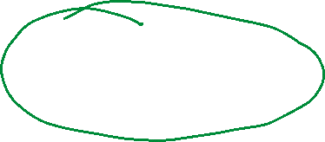






Learning homography parameters
Homography is not linear – cannot be solved in closed form. Convert to other homogeneous coordinates
Both sides are 3x1 vectors; should be parallel (picture as directions, or vectors emanating out of the camera); and so cross product will be zero:
Computer vision: models, learning and inference. ©2011 Simon J.D. Prince
26

Slide 27
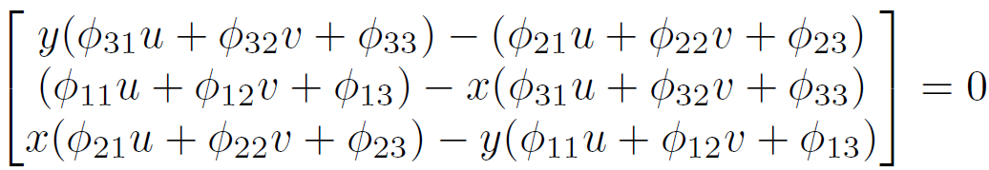
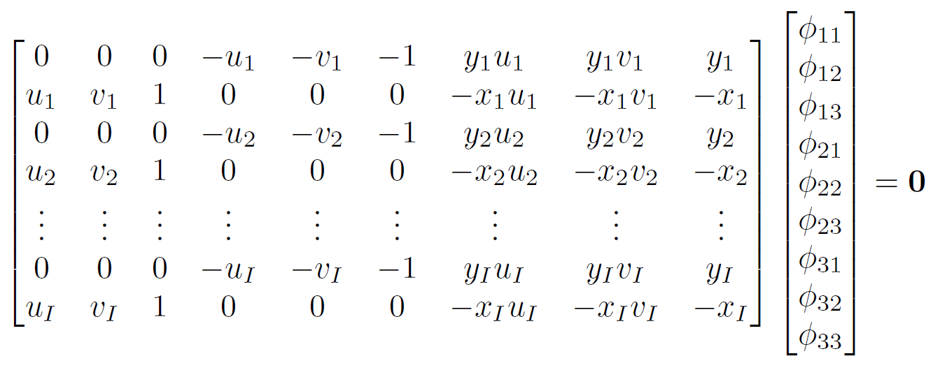
Learning homography parameters
Write out these equations in full
There are only 2 independent equations here – use a minimum of four points to build up a set of equations
Computer vision: models, learning and inference. ©2011 Simon J.D. Prince
27

Slide 28
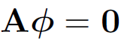




Learning homography parameters
These equations have the form , which we need to solve with the constraint
This is a “minimum direction” problem
Compute SVD
Take last column of
Then use non-linear optimization
Computer vision: models, learning and inference. ©2011 Simon J.D. Prince
28

Slide 29
Inference problems
Given point x* in image, find position w* on object
Computer vision: models, learning and inference. ©2011 Simon J.D. Prince
29

Slide 30




Inference
In the absence of noise, we have the relation , or in homogeneous coordinates
To solve for the points, we simply invert this relation
Computer vision: models, learning and inference. ©2011 Simon J.D. Prince
30

Slide 31
Structure
Transformation models
Learning and inference in transformation models
Three problems
Exterior orientation
Calibration
Reconstruction
Properties of the homography
Robust estimation of transformations
Applications
Computer vision: models, learning and inference. ©2011 Simon J.D. Prince
31

Slide 32


Problem 1: Learning extrinsic parameters (exterior orientation)
3D
review
Use maximum likelihood:

Slide 33



Exterior orientation
3D
Start with camera equation in homogeneous coordinates
Pre-multiply both sides by inverse of camera calibration matrix
33

Slide 34

Exterior orientation
3D
The third equation gives us an expression for λ
Substitute back into first two lines
34

Slide 35







Exterior orientation
3D
Linear equation – two equations per point – form system of equations
35

Slide 36






Exterior orientation
3D
Minimum direction problem of the form , Find minimum of subject to .
To solve, compute the SVD and then set to the last column of .
36

Slide 37





Exterior orientation
3D
Now we extract the values of and from .
Problem: the scale is arbitrary and the rows and columns of the rotation matrix may not be orthogonal.
Solution: compute SVD and then choose .
Use the ratio between the rotation matrix before and after to rescale
Use these estimates for start of non-linear optimisation.
37

Slide 38


Problem 1: exterior orientation
H
Computer vision: models, learning and inference. ©2011 Simon J.D. Prince
38

Slide 39














Problem 1: exterior orientation
H
Writing out the camera equations in full
Estimate the homography from matched points
Factor out the intrinsic parameters
Computer vision: models, learning and inference. ©2011 Simon J.D. Prince
39

Slide 40












Problem 1: exterior orientation
H
To estimate the first two columns of rotation matrix, we compute this singular value decomposition
Then we set
Computer vision: models, learning and inference. ©2011 Simon J.D. Prince
40

Slide 41








Problem 1: exterior orientation
H
Find the last column using the cross product of first two columns
Make sure the determinant is 1 – if it is -1 then multiply last column by -1.
Find translation scaling factor between old and new values
Finally, set
Computer vision: models, learning and inference. ©2011 Simon J.D. Prince
41

Slide 42
Structure
Transformation models
Learning and inference in transformation models
Three problems
Exterior orientation
Calibration
Reconstruction
Properties of the homography
Robust estimation of transformations
Applications
Computer vision: models, learning and inference. ©2011 Simon J.D. Prince
42

Slide 43


Problem 2 – Learning intrinsic parameters (calibration)
3D review
Use maximum likelihood:

Slide 44


Calibration
3D
One approach (not very efficient) is to alternately
Optimize extrinsic parameters for fixed intrinsic
Optimize intrinsic parameters for fixed extrinsic
Then use non-linear optimization.

Slide 45

Intrinsic parameters
3D
Maximum likelihood approach
This is a least squares problem.

Slide 46






Intrinsic parameters
3D
The function is linear w.r.t. intrinsic parameters. Can be written in form
Now solve least squares problem

Slide 47


Problem 2: calibration
H
Computer vision: models, learning and inference. ©2011 Simon J.D. Prince
47

Slide 48

Structure
H
Computer vision: models, learning and inference. ©2011 Simon J.D. Prince
48

Slide 49


Calibration
H
One approach (not very efficient) is to alternately
Optimize extrinsic parameters for fixed intrinsic
Optimize intrinsic parameters for fixed extrinsic
Then use non-linear optimization.

Slide 50
Structure
Transformation models
Learning and inference in transformation models
Three problems
Exterior orientation
Calibration
Reconstruction
Properties of the homography
Robust estimation of transformations
Applications
Computer vision: models, learning and inference. ©2011 Simon J.D. Prince
50

Slide 51


Problem 3 – Inferring 3D points (triangulation / reconstruction)
3D
review
Use maximum likelihood:

Slide 52


Reconstruction
3D
Write j^{th} pinhole camera in homogeneous coordinates:
Pre-multiply with inverse of intrinsic matrix

Slide 53


Reconstruction
3D
Last equations gives
Substitute back into first two equations
Re-arranging, get two linear equations for [u,v,w]
Solve using >1 cameras and then use non-linear optimization

Slide 54




Problem 3 - reconstruction
H
Transformation between plane and image:
Point in frame of reference of plane:
Point in frame of reference of camera
Computer vision: models, learning and inference. ©2011 Simon J.D. Prince
54

Slide 55
Structure
Transformation models
Learning and inference in transformation models
Three problems
Exterior orientation
Calibration
Reconstruction
Properties of the homography
Robust estimation of transformations
Applications
Computer vision: models, learning and inference. ©2011 Simon J.D. Prince
55

Slide 56

Transformations between images
So far we have considered transformations between the image and a plane in the world
Now consider two cameras viewing the same plane
There is a homography between camera 1 and the plane and a second homography between camera 2 and the plane
It follows that the relation between the two images is also a homography
Computer vision: models, learning and inference. ©2011 Simon J.D. Prince
56

Slide 57


Properties of the homography
Homography is a linear transformation of a ray
Equivalently, all images formed by all planes that cut the same ray bundle are related by homographies.
Computer vision: models, learning and inference. ©2011 Simon J.D. Prince
57

Slide 58


Camera under pure rotation
Special case is camera under pure rotation.
Homography can be showed to be
Computer vision: models, learning and inference. ©2011 Simon J.D. Prince
58

Slide 59
Structure
Transformation models
Learning and inference in transformation models
Three problems
Exterior orientation
Calibration
Reconstruction
Properties of the homography
Robust estimation of transformations
Applications
Computer vision: models, learning and inference. ©2011 Simon J.D. Prince
59

Slide 60

Robust estimation
Least squares criterion is not robust to outliers
For example, the two outliers here cause the fitted line to be quite wrong.
One approach to fitting under these circumstances is to use RANSAC – “Random sampling by consensus”
Computer vision: models, learning and inference. ©2011 Simon J.D. Prince
60

Slide 61

RANSAC
Computer vision: models, learning and inference. ©2011 Simon J.D. Prince
61

Slide 62


RANSAC
Computer vision: models, learning and inference. ©2011 Simon J.D. Prince
62

Slide 63

Fitting a homography with RANSAC
Original images
Initial matches
Inliers from RANSAC
Computer vision: models, learning and inference. ©2011 Simon J.D. Prince
63

Slide 64

Piecewise planarity
Many scenes are not planar, but are nonetheless piecewise planar
Can we match all of the planes to one another?
Computer vision: models, learning and inference. ©2011 Simon J.D. Prince
64

Slide 65

Approach 1 – Sequential RANSAC
Problems: greedy algorithm and no need to be spatially coherent
Computer vision: models, learning and inference. ©2011 Simon J.D. Prince
65

Slide 66

Approach 2 – PEaRL (propose, estimate and re-learn)
Associate label l which indicates which plane we are in
Relation between points x_{i} in image1 and y_{i} in image 2
Prior on labels is a Markov random field that encourages nearby labels to be similarx
Model solved with variation of alpha expansion algorithm
Computer vision: models, learning and inference. ©2011 Simon J.D. Prince
66

Slide 67


Approach 2 – PEaRL
Computer vision: models, learning and inference. ©2011 Simon J.D. Prince
67

Slide 68
Structure
Transformation models
Learning and inference in transformation models
Three problems
Exterior orientation
Calibration
Reconstruction
Properties of the homography
Robust estimation of transformations
Applications
Computer vision: models, learning and inference. ©2011 Simon J.D. Prince
68

Slide 69
Augmented reality tracking
Computer vision: models, learning and inference. ©2011 Simon J.D. Prince
69

Slide 70


Fast matching of keypoints
Computer vision: models, learning and inference. ©2011 Simon J.D. Prince
70

Slide 71

Visual panoramas
Computer vision: models, learning and inference. ©2011 Simon J.D. Prince
71

Slide 72
Conclusions
Mapping between plane in world and camera is one-to-one
Takes various forms, but most general is the homography
Revisited exterior orientation, calibration, reconstruction problems from planes
Use robust methods to estimate in the presence of outliers
Computer vision: models, learning and inference. ©2011 Simon J.D. Prince
72

